Slide 1
Interreg Europe key features
Erwin Siweris
Programme Director | Interreg Europe
e.siweris@interregeurope.eu
13 April 2016Info Day in Bucharest

Slide 2
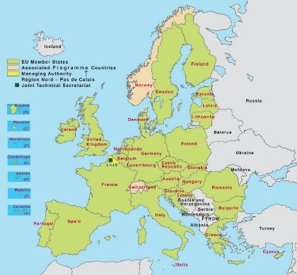
Geographical & thematic focus
The only Interreg covering
EU 28 + NO & CH
A thematic programme

Slide 3
Interreg Europe rationale
Objective set in the ETC Regulation - Article 2(3)(a) for interregional cooperation:
“to reinforce the effectiveness of cohesion policy”
“identification and dissemination of good practices with a view to their transfer principally to operational programmes under the Investment for growth and jobs goal but also, where relevant, to cooperation programmes”

Slide 4
Interreg Europe rationale
Exchange of experience to improve performance of policies for regional development, in particular Structural Funds (SF) programmes
EU Cohesion policy
Goal 1: Investment for growth & jobs
EUR 340 billion
Goal 2: European Territorial Cooperation
EUR 10.2 billion
INTERREG EUROPE
EUR 359 m

Slide 5
Multidimensional aspect of learning
3. Regional stakeholders learning
2. Organisational learning
4. External /
EU level learning
1. Individual learning
Go beyond individual / organisational learning!

Slide 6
How can you improve a policy?
Different possibilities
Implement new projects
Change programme governance
Change programme content
May not require funding!

Slide 7
Implement new projects
Practice:
Research & development Card: advisory & financial support to SMEs for the development of innovative products
From: Västra Götaland (SE) To: Lower Silesia (PL)
5.4 million zł (MEUR 1.35) financed from the ESF Operational Programme of Lower Silesia

Slide 8
Change programme governance
Modification of the monitoring system for the evaluation of the innovation measures in the regional operational programmes of:
Bretagne (FR)
PACA (FR)
Puglia (IT)
Wielkopolska (PL)

Slide 9
Change programme content
Partner
Bulgarian Ministry of Labour and Social Policy
Improved policy
Bulgarian ESF development programme
ESF ‘Development’ programme tackling unemployment after mass redundancies in enterprises. Thanks to the project, the programme was modified to include preferential treatment to people age 50+.

Slide 10
Supported actions
Projects
Involving limited number of regions
2 phases
Stakeholder groups
Action Plans
Policy learning platforms
Open to all
Closely related to projects

Slide 11
Target groups
Managing
authorities
Regional / local authorities
Learn from each other to improve policies
Agencies, institutes, private non-profits

Slide 12
Projects: features
Implementation in 2 phases
Policy exchange of experience (1 to 3 years)
ending with production of 1 action plan per region
Monitoring of action plan implementation
(2 years) + possible pilot actions
Focus on Structural Funds
At least half of policy instruments addressed must be SF
Phase 1
Phase 2

Slide 13
Project partnership requirements
Min 3 countries represented (including 2 EU MS)
Recommendation: between 5 to 10 partners
Involvement of policy responsible organisations
Directly as partners
Indirectly through support letters (and through participation in stakeholder groups)
Creation of stakeholder groups
Contribute to success of learning process by involving all relevant organisations
Reduce obstacles to action plan implementation

Slide 14
Projects: who is eligible?
Public bodies (main target group) (e.g. local, regional, national authorities)
Bodies governed by public law (Directive 2004/18/EC)
Private non profit bodies
Co-financing rates | According to legal status or location
85% ERDF | Public or public equivalent from EU
75% ERDF | Private non-profit from EU
50% Norwegian funding | Public, public equivalent and private non-profit from NO
Swiss funding | Public, public equivalent and private non-profit from CH

Slide 15
Projects: simplifications
Online (OLF) system
Application, report, request for changes
More budget flexibility
20% flexibility rules within approved budget
No financial reporting per component
Fewer control steps
No reconfirmation of partnership cost on lead partner level
Simpler administration
Lump sum preparation costs (EUR 15,000)
Flat rate administration costs (15% of staff costs)

Slide 16
Platforms: definition
A service provided per priority axis via:
Online collaborative tool
With relevant functionalities
Expert team
Content & coordination

Slide 17
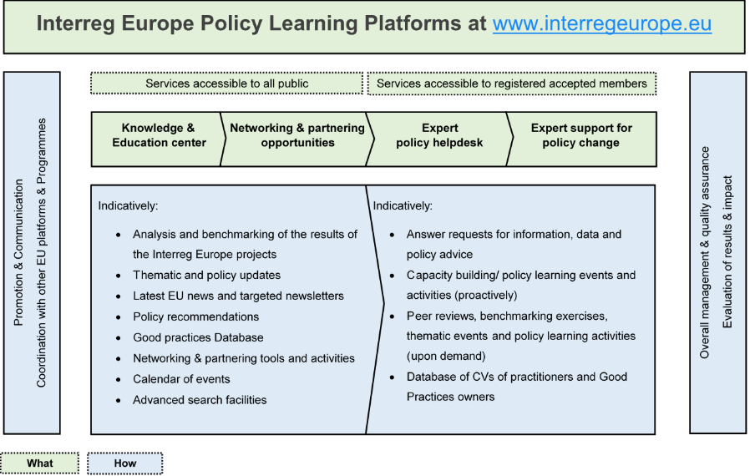
Platforms: services provided
Notes:
The 4 services following interest for involvement of the users. These categories are presented as non exhaustive, subject to legal restrictions.

Slide 18
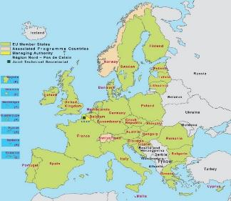
Two interrelated actions
Policy Learning Platforms
Open to all regions
Enrich
Contribute
Interregional cooperation projects
Project 1
Project 2
Project 3

Slide 19
For more information
Programme website
www.interregeurope.eu
Programme manual
www.interregeurope.eu/help/programme-manual/
Interreg Europe community
www.interregeurope.eu/account/dashboard/

Slide 20
Thank you!
Questions welcome

