Slide 2
For potential buyers we offer
Unique B2B platform for mechanical engineering
Permanent continuous approachable
Free to visit and requires no login nor password
Covering many sectors:
- Process equipment and components
- Drives and transmissions
- Hydraulics and pneumatics
- Pumps and rotating machines
- Tools, tooling and dies
- Castings and forgings
- Metalworking and machinery

Slide 3
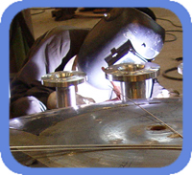
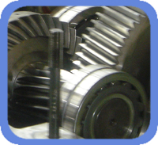
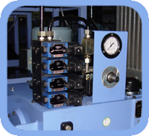
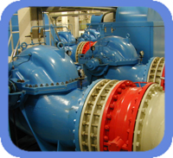
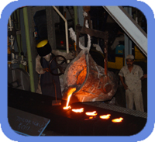
For potential buyers we present
All verified companies with good quality control
From many parts of the world
Mostly from emerging markets

Slide 4
The KommaTrade team
Our team of specialists heading different sections, multi-lingual and multi-functional

Slide 5
The KommaTrade team
We form a dedicated team of:
- Experienced engineers
- Global marketers
- Knowledgeable IT specialists
- Experienced researchers
- Digital experts
All under one roof
- Supported by our agents

Slide 6
KommaTrade worldwide
We have built a worldwide network with qualified engineers, all trained by us.
These agents are motivated to assist you with your sourcing and sales requirements.
Our international community was gradually build by visiting producers in countries like:
India
Philippines
Peru

Slide 7
KommaTrade worldwide agents

Slide 8
Expertise in export and sourcing
We cover the entire field of mechanical engineering
Presenting verified manufacturers on our KommaTrade portal
Products: Castings, forgings and machining
CNC machining and assemblies
All kind of pumps for water, oil and chemicals
Gear transmissions and electric drives
Hydraulic cylinders and pneumatic components
Tools, tooling and dies
Pressure and heat transfer equipment
Pipes, tubes, couplings and fittings

Slide 9
KommaTrade platform activities
We support the KommaTraders on our permanent exhibition with:
- individual presentations to buyers
- promotion in our social media
- export marketing research
- export training through Master Classes
- export advice and support
- partner and acquisition activities

Slide 10
Services of KommaNet
KommaNet is a sister company of KommaTrade. We perform some of the specialised services
for KommaTrade, such as:
Export training for our exhibiting clients
Search for bussiness alliances
Search for cooperation partners
Advice on international collaborations

Slide 11
Finding business alliances
For our premium KommaTrade members we perform professional
international partner searches:
Mergers : buying or selling
Acquisitions : take overs and buy-outs
Joint-ventures : close co-operations
Other projects : on the basis of exclusive mandates

Slide 12
For exhibitors
We build your profile on our permanent internet company exhibition with:
- Your logo + description + website
- Contact details for communications
- Representative portrait photo
- Product photographs + pictures
- Brochures to be uploaded
- Uploaded videos
- Highlights and reviews

Slide 13
For exhibitors
They can choose from the following subscriptions:
BASIC, simple listing in our web directory
PLUS, regular promotions in our communities
PREMIUM, frequent promotions, also with selective presentations
PREMIUM PLUS, all the above plus alliance searches
Depending on client’s choice we perform additional personalized services

Slide 14
Associate with us
You have a chance to become a "KommaTrader"
Through our website www.kommatrade.com you can easily join this exclusive community

Slide 15
Building a community
We have built several communities of interesting people in mechanical engineering
Buyers and purchasers
Company owners
CEOs of big companies
Consultants and advisors
Associations and clusters
And the expansion of these communities is continuing

Slide 16
Benefits to Join us as a KommaTrader
Part of a growing and appreciated platform
Regular presentations to selected potentials
Access to professional information and advice
Knowledgeable experienced people at your side
Part of an advanced engineering/marketing combination
Worldwide coverage

Slide 17
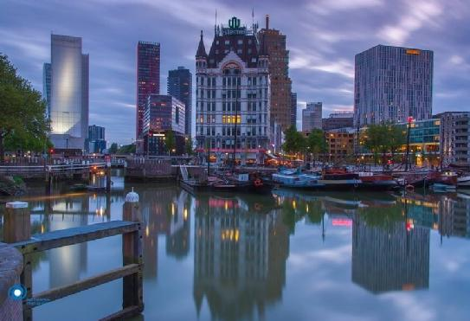
Thank you
Our country is very small but dynamic
Traditionally we are dependent on other countries
The Dutch are found and accepted everywhere
Join us to open your vision and world

